Slide 1
Electronic Payments
15-421/08-761/46-861/46-869 -- Fall 2013 – Lecture 16
Information Security & Privacy
Norman M. Sadeh
School of Computer Science
Carnegie Mellon University

Slide 2
Practical Info – 2nd Half of the Semester
Mini-semester students:
  HW assignment out by Friday evening (Nov 8)
Everyone:
  No class this coming Thursday
  Instead, the lecture on Big Data and Privacy will be on: Tuesday November 26

Slide 3
Grading for Mini-2 students
HW assignment: 30%
  Out by Friday Nov 8
  Due by Friday Nov 22
Case Study – teams of 2
  Topics to be identified together
  Case presentation: 10%
  Case report: 25%
Final exam: 35%
Class participation: taken into account in final letter grade

Slide 4
This Lecture
E-Payment Systems
Student Lecture: Bitcoin
References

Slide 5
Main Types of Payment Systems
Cash
Checking Transfer
Credit Card
Stored Value
Accumulating Balance

Slide 6
Question
Identify desirable attributes of B2C payment mechanisms
  For consumers
  For merchants
  For financial intermediaries

Slide 7
Conflicting Considerations
Cost, float & risk, security (e.g. ease to steal, counterfeit, etc.), privacy/anonymity, ease of use, etc.
Tradeoffs lead to the co-existence of multiple solutions

Slide 8
Online Payments
The Web has introduced new requirements
  Web-based P2P payments (e.g. auction sites)
  Online products sold for a few dollars or less (e.g. iTunes, ringtones, Facebook games, e-Books, etc.): micropayments
  Web-based B2B payments
In general online payments include:
  Adaptation of traditional offline payment solutions (e.g. credit card over TLS)
  Entirely new solutions (e.g. PayPal, Felica, Facebook Credits, Google Mobile Wallet, Square, Bitcoin, etc.)

Slide 9
Most Common Form of B2C Payment
Most common form of online B2C payment:
  In the US: credit card payment over TLS
  Elsewhere – depends on country’s financial infrastructure
    e.g. Japan: more bank transfers, cash on delivery (COD) at drop off points, etc.

Slide 10
Forms of Online Payment
Digital Cash
  Private form of currency that can be spent at e-commerce sites (e.g. Linden dollars, Facebook credits, Bitcoins)
Online Stored Value Systems
  Relies on prepayment (e.g. gift cards)
  Paypal, Skype, Octopus card
Digital Accumulating Balance Payment Systems
  Accumulate small charges & bill periodically
  Good for micropayments (e.g. cell phone operators)
Digital Credit Accounts
  Extend functionality of credit cards
Digital Checking
  Extend functionality of existing bank checking systems
A number of mobile payment solutions tied to credit and debit cards (e.g. iTunes, Google Mobile Wallet)

Slide 11
Online Credit Card Payments (simplified)
5. Credits merchant account
Merchant Bank
(“Acquiring Bank”)
4. Updates credit balance
Issuing bank
Clearinghouse
Verifies account and
Balance with issuing bank
6. Authorization confirmation
Monthly
statement
2. Sends cc info to Clearinghouse
1. Gives cc details
Online
Customer
Merchant
TLS
Later merchant batches authorizations & submits to acquiring bank

Slide 12
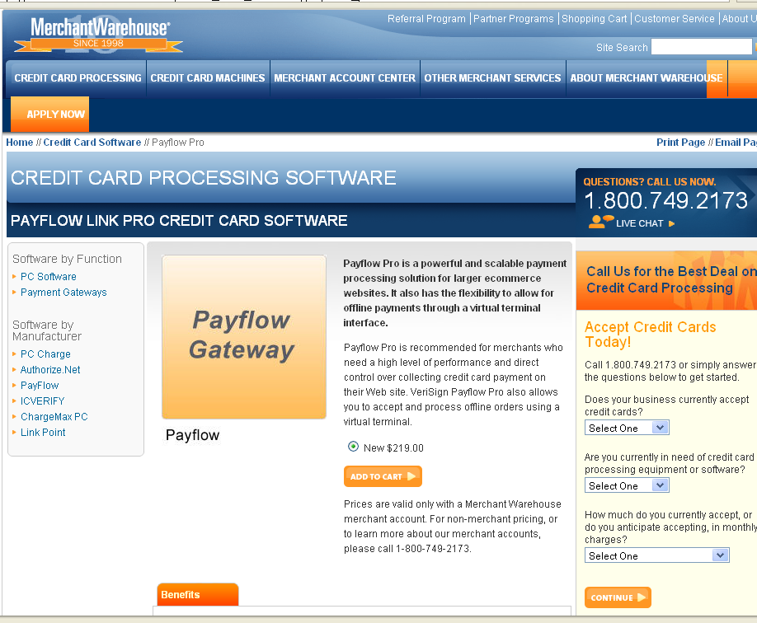
Internet Payment Service Providers
Provide merchant accounts & software for processing credit card payment

Slide 13
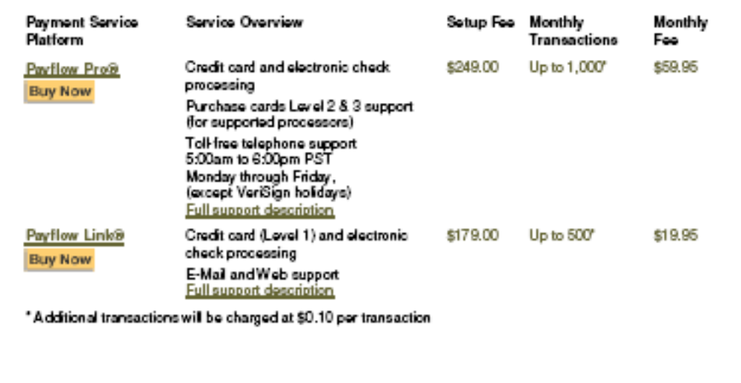
Limitations of Online CC Payments
TLS
  Typically just server side authentication
Costs to merchant
  Approx. 3-5%
  20+ cents/transaction fee
  Additional setup fees
Undesirable for micropayments

Slide 14
Secure Electronic Transactions (SET)
Protocol developed by Visa and Mastercard
Authenticates cardholder and merchant, using digital signatures
  Merchants required to have digital certificates issued by acquiring banks
  Consumers have certificates from their issuing banks
Selective information disclosure
  Some info is private between merchant and customer (e.g. items being purchased)
  Some info is private between customer and issuing bank (e.g. customer’s account number)

Slide 15



SET Implementation
A single purchase request with 2 fields and a dual signature
Customer
Message
To Merchant
(Order)
Customer
Message
To Acquiring Bank
(Authorization)
“Order” fields
encrypted
with
Merchant
Public Key
“Authorization” fields
encrypted with
Acquiring Bank
Public Key
M1 Message Digest
M2 Message Digest
Dual Customer Signature of M3 =Digest(M1+M2)
Digest of concatenated digest M1 and M2
is signed with Customer Private Key
Dual Signature:
Prevents repudiation of coupled Order and Authorization by linking both parts of the message
Dual signature can be verified with message digests of M1 and M2 but doesn’t require seeing both original messages

Slide 16
SET Question
A single purchase request with 2 fields and a dual signature
Customer
Message
To Merchant
(Order)
Customer
Message
To Acquiring Bank
(Authorization)
Encrypted
With
Merchant
Public Key
Encrypted
With
Acquiring Bank
Public Key
M1 Message Digest
M2 Message Digest
Dual Customer Signature of M3 =Digest(M1+M2)
Digest of concatenated digest M1 and M2
is signed with Customer Private Key
What if:
Merchant substitutes a new message to the acquiring bank (e.g asking for more money) along with a new message digest M2?

Slide 17
SET Adoption
Unsuccessful
Despite higher security
Usability has been key impediment
  User required to download digital wallet software
  User required to obtain digital certificates for each credit card
Few websites offer SET
  Not very compelling for a user
SET merchant channel allowed merchants to obtain credit card numbers from acquiring bank anyway – compatibility with legacy systems
  Defeats the confidentiality of SET as far as disclosure of credit card number to merchant is concerned
Could change with credit cards with built-in smart cards

Slide 18
Micropayments
Low value transactions- typically less than $5 (often less than a $1)
Application
  Face to face
    Vending machines
    Pay phones
    Toll
    Parking
  Remote
    Paying for web content or services ( example weather forecast, ringtones, i-Tunes, etc.)

Slide 19

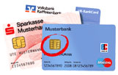
GeldKarte – started in 1997
A German smart card e-purse solution
  Chip on Maestro or banking card
  Association of all German banks
  Interoperability with similar schemes in other countries – e.g. France, Luxembourg
Manufactured by Siemens/ Motorola, 12K ROM,256 bytes RAM, and 8K eeprom
Over 60 million users in Germany , Switzerland, Austria, Netherlands, etc.
Can be loaded with a maximum of 200 Euros
Bank charge 0.3%, minimum $0.01

Slide 20
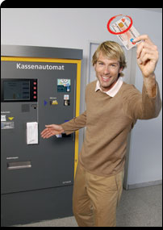

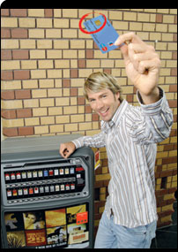
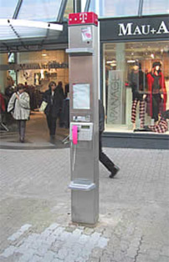
Uses
Public transportation
Vending machines
Parking
Public phones
Laundromats
Tickets
Retailers
Online payment with secure card reader

Slide 21
Initialization Phase
PIN is selected and stored along with custID, and secret key(symmetric key), stored in a ‘secret zone’ in the card
  Key is used to protect bank account linked to the card – e.g. to load cash
  Above information is also stored in an encrypted form at the issuing bank – symmetric key
Shadow account linked to each card (but not to the individual)
  Updated when money loaded/spent
  Used also when card is lost/stolen to see how much was left

Slide 22
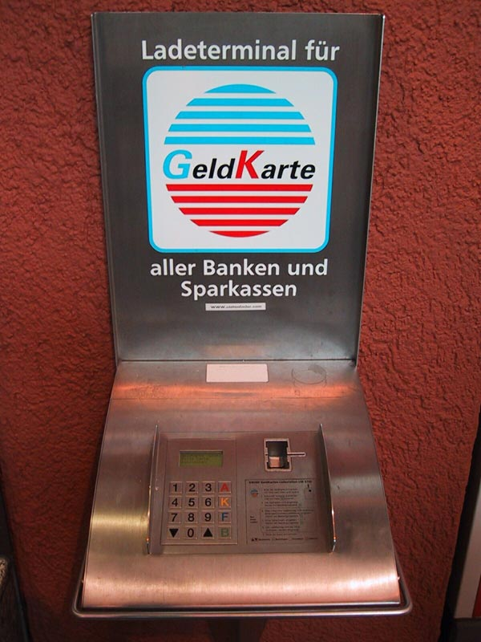
Loading GeldKarte
Card is inserted into a payment station (similar to an ATM)
Card authentication
Card holder authentication (pin)
Input the value to be loaded
Authorization
Update and synchronization of the records of all the parties

Slide 23
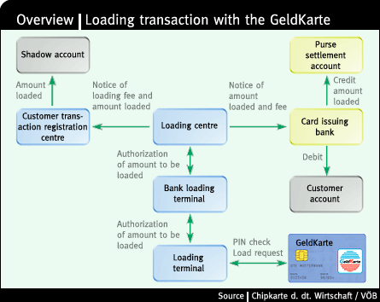
Loading GeldKarte - II
Purse
Settlement
Account =
Pool from
Which
Merchants
Are paid

Slide 24
GeldKarte Payment
Customer inserts GeldKarte in merchant terminal
Mutual authentication (no pin used)
Transfer of amount
Generate receipt
Later- Merchant batches receipts and presents to bank for settlement
  Claims as a result to be anonymous
    Merchant cannot identify customer

Slide 25
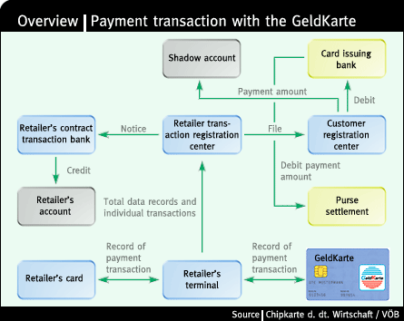
GeldKarte Payment
Purse
Settlement
Account =
Pool from
Which
Merchants
Are paid
Retailer
Chip sits in
the terminal

Slide 26
Additional Usage Information
Average transaction value
  1997: 11 Euros
  1998: 6 Euros
  1999: 4 Euros

Slide 27
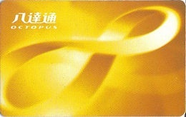
Octopus Card
Hong Kong Octopus Card
  Launch in September 1997
  Stored value card for fare collection system for the Hong Kong’s mass transit systems
  Covers public transport, parking, retail, supermarket, restaurant, access control, etc
Transaction fees: HK$0.02 + 0.75%
  $10 transaction costs $0.095 (0.95%)
16 Million cards in circulation
95% of Hong Kong population
10 Million transactions per day
HK$29 billion per year in transactions

Slide 28
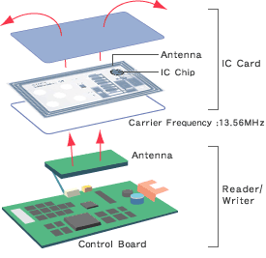
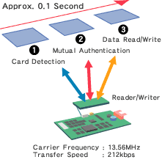
Contactless Smart Cards/NFC
Source: Sony (http://www.sony.net/Products/felica/contents02_02.html)
FeliCa: transaction within 0.1 sec incl. mutual authentication

Slide 29
Taxonomy of Mobile Payment Solutions
Direct Mobile Billing – cell phone operator
“In-app” payments – App Store, Android, RIM
SMS Solutions
Email Solutions
Mobile Web Payments
Contactless Payment (NFC)
Miscellaneous solutions for credit card processing
And more (e.g. Google Mobile Wallet, Square)

Slide 30
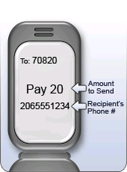
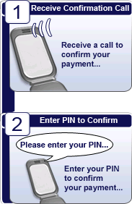
TextPayMe - I
  P2P – PayPal-like but based on SMS
Can be linked to bank account and credit card
Supports a small number of simple commands (pay, bal, req, refer,
signup, alias, help)

Slide 31
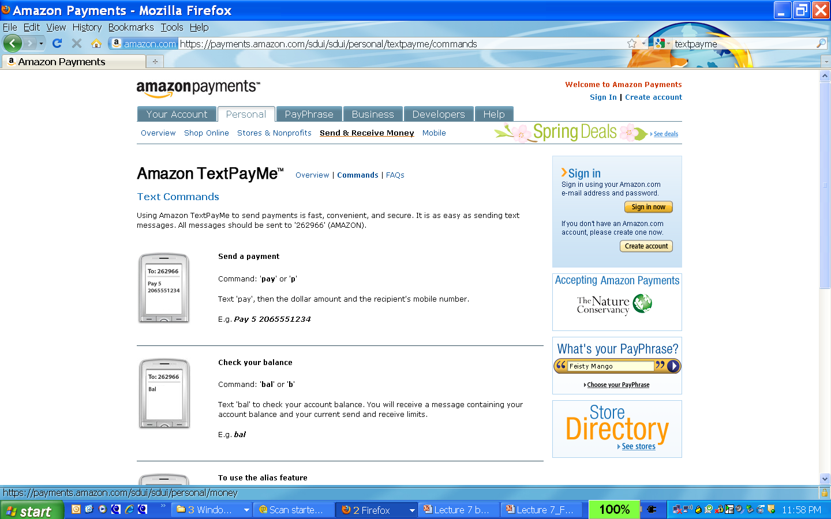
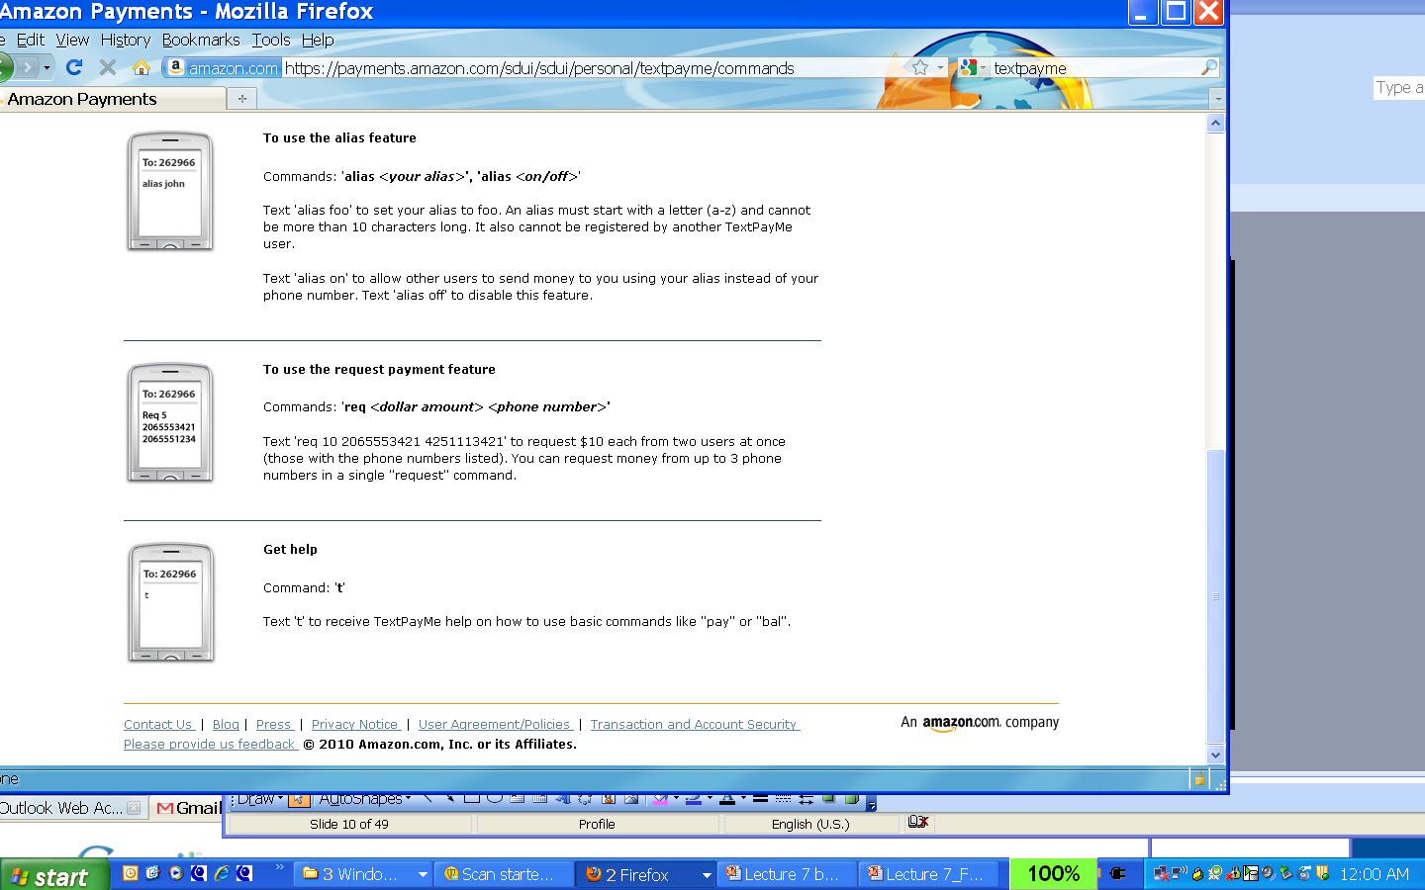
TextPayMe - II
Recently acquired by Amazon
Complete set of commands
https://payments.amazon.com/sdui/sdui/personal/textpayme

Slide 32
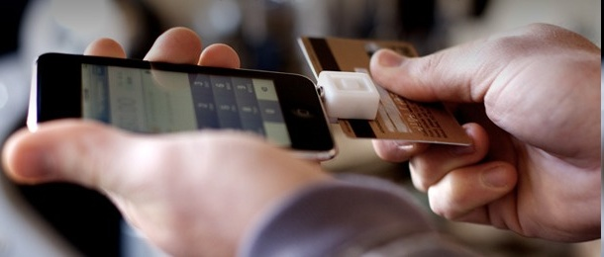
Square - I
Uses a dongle that plugs into audio jack of cell phones or laptop
Dongle given away for free
Simple transaction fee: 2.75%
Gives 1 penny to charity of choice

Slide 33
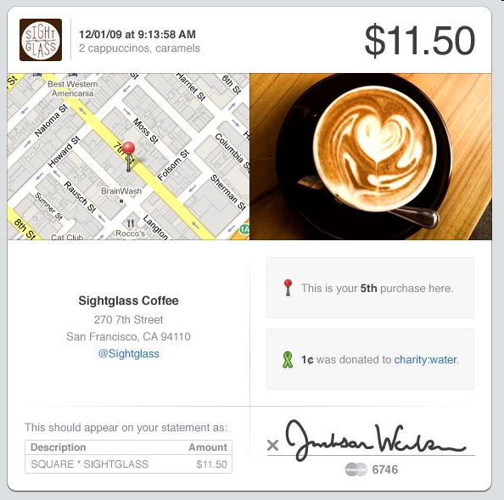
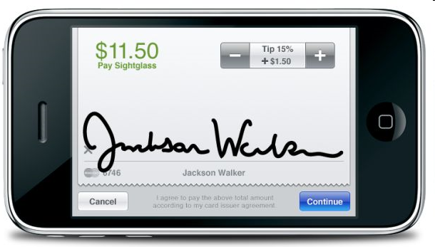
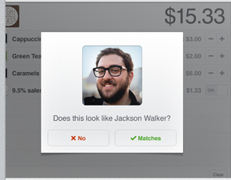
Square - II

Slide 34

Another Example: i-mode Felica
Mobile Wallet (“Osaifu-Keitai”)
  Uses Near-Field Communication (NFC) to support communication with reader
  Multi-application smart card
  Shopping, transportation, ticket, membership card, key/id, online shopping
  Launched in July 2004
  Sold 1 Million units in the first 5 months

Slide 35
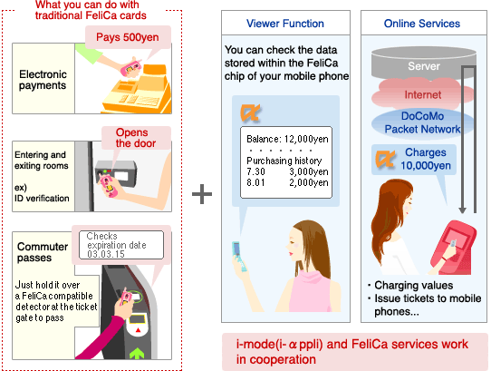
i-Mode Felica Services
Source:
NTTDoCoMo
website

Slide 36
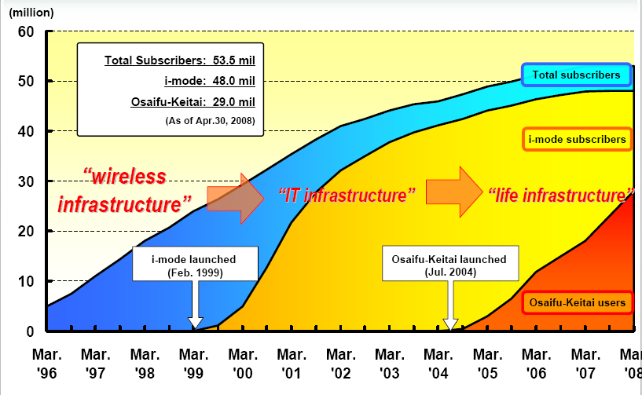
Adoption of Osaifu-Keitai: Approx. 29M users by Apr. 2008
Source: DoCoMo site

Slide 37
Pay with Square
Mobile App that has your CC info and your picture
When you walk into a store, your presence is sensed via GPS
The attendant sees your profile and picture
If you purchase something, the attendant can directly charge it to your account
Your phone vibrates to confirm the transaction

Slide 38
Conclusions
All payment systems have
  Risk and a cost to mitigate risk
  The cost includes possible usability hurdles
  To be compelling enough payment schemes have to be widely accepted
    Interoperability, upfront investments, etc.
Merely addressing the technical issues or going overboard with cryptography is not good enough
Successful schemes today CC over TLS, GeldKarte, Octopus, Paypal, etc.
Simpler systems that take all the factors (human, cultural, business, etc) and not just technological ones are more likely to succeed

Slide 39
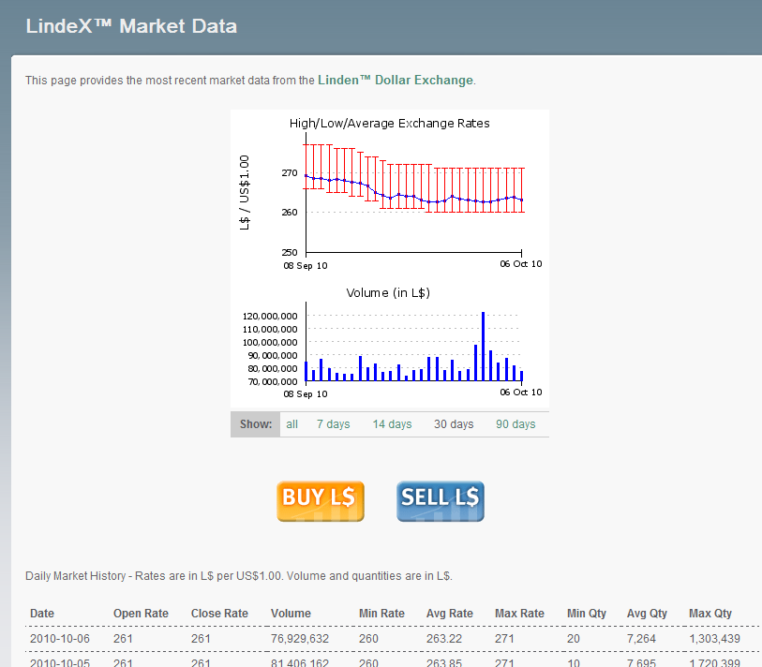
Linden Dollars

Slide 40
References for this Lecture
Required Readings:
  Web Security, Privacy and Commerce, Garfinkel & Spafford, Ch. 25, pp. 628-630 for SET
  GeldKarte http://www.geldkarte.de/_www/en/pub/geldkarte/geldkarte_users.php
    Click on the British flag for the English version
  “The Death of Cash”, Fortune Jul. 2012: http://tech.fortune.cnn.com/2012/07/09/dorsey-square-death-cash/
  http://www.businessinsider.com/how-pay-with-square-will-work-at-starbucks-2012-8
Optional Reading:
  Web Security, Privacy and Commerce, Garfinkel & Spafford, Ch. 25

Slide 41

Q&A

Slide 42
Additional Slides on Advantages and Disadvantages of Different (Traditional) Payment Methods
08-761/46-861 -- Fall 2013 – Lecture 16
Information Security & Privacy
Norman M. Sadeh
School of Computer Science
Carnegie Mellon University

Slide 43
Cash
Legal tender defined by a national authority
Most common form of payment in terms of number of transactions
Advantages:
  no intermediation
  Easy to use
  Requires no authentication
  Allows for micropayments, since it’s use is free
  Anonymous use
Disadvantages:
  Easily stolen
  No float
    Period of time between purchase & actual payment
  Anonymity (e.g. if you’re concerned about illegal trade)

Slide 44
Checking Transfer
Funds transferred directly via a signed draft or check
Most common method of payment in the US in terms of dollar volume (and 2nd in terms of # transactions)
Can be used for both large and small payments
Requires 3rd party processing
Has some float
No anonymity
Easier to forge than cash
  Authentication required
Risk to merchant: can be canceled or bounce
  Ensured checks (e.g. money order) aim to reduce these risks

Slide 45
Credit Cards
Second most common form of payment in terms of transaction volume (after checks)
Extend credit to consumers
  Purchase items while deferring payment
Visa, Mastercard: credit card associations that set standards
Issuing banks are the ones actually issuing credit cards
Processing centers & clearinghouses verify accounts and balances

Slide 46
Credit Cards - II
Reduce risk of theft associated with carrying cash & convenience of not having to carry cash
Substantial float
  Customer pays 30 days after end of billing cycle
Merchants pay hefty transaction fees (approx. 3-5% of purchase price) to issuing bank
Federal Regulation Z and E: risk placed on merchants and issuing banks
  Consumer liability limited to $50 for unauthorized transactions – if reported within 2 days
    $500 if reported within 60 days of receiving bank statement
  Additional protection – e.g. Visa zero liability

Slide 47
Credit Card Transaction – Main Steps
Players:
  Customer, merchant, issuing bank, acquiring bank/merchant bank, and clearing center
Main Steps:
Merchant forwards payment details to merchant bank, which verifies account and availability of funds with clearinghouse & issuing bank
  Results in authorization confirmation sent to merchant
Issuing bank later credits merchant bank
Merchant submits batched authorizations to merchant bank & gets credited
Customer later gets billed by issuing bank

Slide 48
Stored Value
Accounts created by depositing funds into an account
  Funds can be withdrawn/paid out as needed
Examples: debit cards, gift certificates, smart cards used as e-purses, etc.
No float
Not covered by Regulation Z & E – little consumer protection
Minimizes risk for merchants – e.g. prepaid phone cards

Slide 49
Accumulating Balance
Accounts that accumulate expenditures and to which consumers make periodic payments
e.g.: traditional (“post-paid”) phone account, other utilities, etc.
  Convenient for accumulating small charges over some period of time
  Merchant needs to check consumer’s credit-worthiness
Has float

